Slide 1




GET
HIRED
Presented by
Aviral Mishra
Harsh Kumar Srivastava
Harsh Vardhan Rai
Khushi Jalan

Slide 2

﻿Abstract
This machine learning project predicts employee termination and student placement using academic performance, project accomplishments, and work history data.
Employing advanced algorithms, it provides precise forecasts and personalized recommendations. Students with lower placement prospects are referred to an ed-tech platform with tailored study resources to enhance employability.
For employees, the project predicts layoff risks, enabling organizations to take proactive measures. At-risk employees are also referred to the ed-tech platform for professional development. This approach fosters continuous learning and career advancement, supporting a dynamic professional and educational ecosystem.

Slide 3
Importance
In the domain of educational and organizational culture, accurate prediction of student placement and employee termination plays a profound and significant role in the effective management of educational and organizational resources.
It forms the foundation of strategic decision-making, resource allocation and individual empowerment and serves as a fundamental tool that shapes individuals in several ways:
Personal Empowerment and preparedness
Resource Efficiency
Strategic Planning
Enhanced Organizational Resilience
Cost Saving

Slide 4

Limitations in
Existing Work
One notable limitation in existing literature is the challenge of accessing layoff data due to its confidential nature within organizations.
Another limitation in existing works on layoff prediction is the inability to capture multiple critical features such as working hours, work culture and leave payoff in data format.
One notable limitation in layoff prediction models is the variability of individual characteristics among employees. Each person possesses unique traits, skills, experiences, and work behaviors that shape their performance and interactions within the organization.
Despite being commonly used as a metric for evaluating student performance, academic scores often do not significantly influence student placement outcomes

Slide 5
Proposed Solution
In contrast to existing projects that focus solely on either student placement or employee termination, our project offers a unique dual prediction capability.
Our project seamlessly integrates an ed-tech website into the predictive framework. This innovative platform offers terminated employees access to meticulously curated study materials tailored to their specific needs and career aspirations.
Setting itself apart from conventional approaches, our project delivers tailored recommendations to both organizations and students, optimizing outcomes for all parties involved.
Central to the success of our project is the utilization of sophisticated machine learning algorithms, meticulously crafted using an extensive array of large-scale datasets.

Slide 6
Modules
Placement Prediction Model
Layoff Prediction Model
Management System

Slide 7
Placement Prediction
The model is designed to ingest structured data encompassing key attributes such as GPA, technical skills rating, soft skills rating, internship experience, and the number of projects completed by each student.
Our model is the process of feature engineering, wherein raw data is transformed into meaningful features that encapsulate predictive information.
Leveraging domain knowledge and statistical techniques, we engineered a diverse set of features that capture the multidimensional nature of student placement.

Slide 8
Placement Prediction Model Performance
Having selected a diverse ensemble of algorithms, we embarked on the process of model training and evaluation to identify the optimal configuration for predicting student placement.
Utilizing a portion of the dataset for training and the remainder for validation, we employed techniques such as cross-validation and holdout validation to assess the performance of each model.
Metrics such as accuracy, precision, recall, and F1-score were computed to quantify the predictive efficacy of the models across different evaluation criteria.

Slide 9
Layoff Prediction
By leveraging historical data and relevant predictors such as years of experience, promotions, departmental affiliation, job title, and the provision of severance packages, machine learning models can provide valuable insights into the likelihood of future layoffs.
This proactive approach enables organizations to implement targeted interventions, such as workforce restructuring, skills development programs, or alternative employment opportunities, to minimize the impact on employees and preserve organizational stability.
By identifying potential risk factors and early warning signs of layoffs, decision-makers can implement preemptive measures to address underlying issues, enhance employee engagement, and foster a culture of transparency and trust within the organization

Slide 10
Layoff Prediction Model Performance
For evaluation, we utilized a range of performance metrics including accuracy, precision, recall, and F1-score to quantify the model's predictive performance across different evaluation criteria.
Through comprehensive evaluation, we gained insights into the model's strengths and limitations, enabling informed decision-making and model refinement

Slide 11

Decision System
fdasf
Trained Model
User Input Data
Decision System
Solution:
Placed / Unplaced
Layoff

Slide 12
Algorithmic Analysis
Logistic Regression
Support Vector Machine (SVM)
Random Forest Algorithm

Slide 13
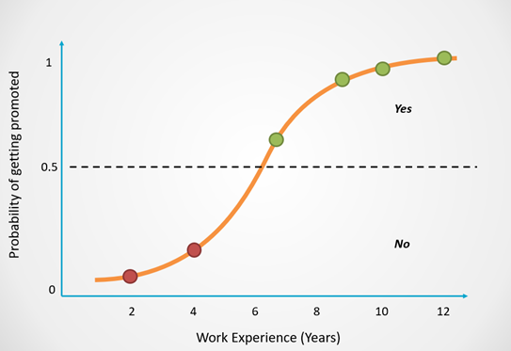
Logistic Regression
Logistic regression is a fundamental statistical method used for binary classification tasks, where the goal is to predict the probability of an observation belonging to a particular class (e.g., laid off or not laid off).
The logistic regression model is trained by maximizing the likelihood of observing the given set of outcomes (labels) given the input features.
The objective is to find the optimal values of the coefficients (also known as weights or parameters) that best fit the training data and minimize the error between predicted and actual outcomes

Slide 14
﻿Pros and Cons
Pros:
Logistic regression is simple, interpretable, and computationally efficient.
It provides probabilistic outputs, making it easy to interpret the confidence of predictions.
Logistic regression can handle both numerical and categorical features gracefully.
Cons:
Logistic regression assumes a linear relationship between the features and the log-odds of the outcome, which may not always hold true in real-world scenarios.
It may struggle with capturing complex non-linear relationships between features and outcomes

Slide 15
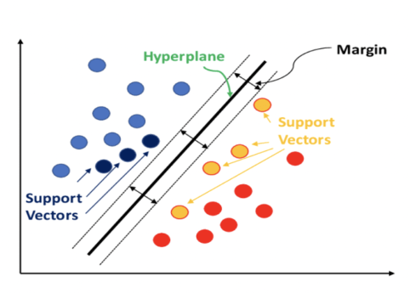
Support Vector Machine
Support Vector Machine (SVM) is a supervised learning algorithm used for classification and regression tasks. In classification, SVM aims to find the optimal hyperplane that separates the data points of different classes with the largest margin, thereby maximizing the margin of separation.
The hyperplane is chosen such that it maximizes the margin, i.e., the distance between the hyperplane and the nearest data points (support vectors) of each class.
SVM can handle both linear and non-linear decision boundaries by employing different kernel functions.

Slide 16
﻿Pros and Cons
Pros:
SVMs are effective in high-dimensional spaces and can capture complex decision boundaries.
They are robust to overfitting, especially in cases where the number of features exceeds the number of samples.
SVMs perform well with small to medium-sized datasets and can handle both linear and non-linear classification tasks.
Cons:
SVMs can be sensitive to the choice of the kernel function and its parameters.
They may require careful tuning of hyperparameters such as the regularization parameter (C) and kernel parameters.
SVMs can be computationally expensive, especially for large datasets with many features.

Slide 17
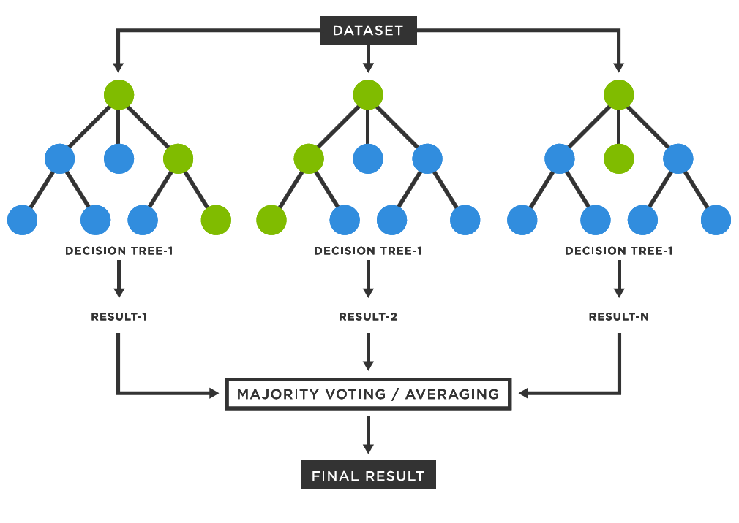
Random Forest
Random Forest is an ensemble learning method used for both classification and regression tasks.
It operates by constructing a multitude of decision trees during training and outputting the mode of the classes (classification) or the average prediction (regression) of the individual trees.
The fundamental idea behind Random Forest is to aggregate the predictions of multiple decision trees to improve the overall predictive performance and reduce the risk of overfitting.
Each decision tree in the Random Forest is trained independently on a random subset of the training data and a random subset of the features

Slide 18
﻿Pros and Cons
Pros:
Random Forests are robust and versatile, capable of handling both classification and regression tasks.
They are less prone to overfitting compared to individual decision trees, thanks to ensemble averaging.
Random Forests provide feature importance scores, allowing insights into the relative significance of different features.
Cons:
Random Forests can be computationally expensive and memory-intensive, especially for large datasets with many features.
They may lack interpretability compared to simpler models like logistic regression.

Slide 19
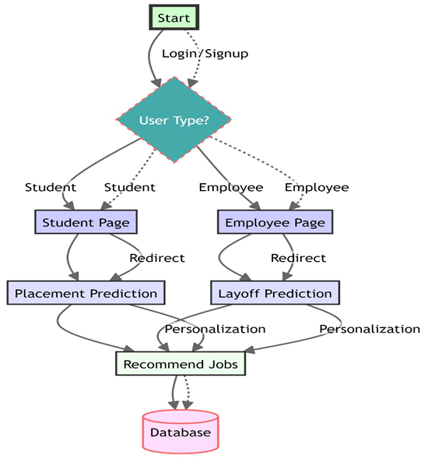
﻿Work Flow
User will first login on the website with either student or employee privilages.
If user enters as student then he/she can predict the placement.
And if user enters as an employee then he/she can predict the possibility of being terminated from the job
And then recommended courses or job will be suggested to him

Slide 20
Management System
Management System comprises of two modules:
Web Application - The web application developed for the Get-Hired project serves as an advanced ed-tech service platform, offering personalized career recommendations and seamless interaction for both students and professionals.
Job Scraper - It involves using Selenium's automation capabilities to navigate through web pages, interact with elements, and extract desired information

Slide 21
Web Application
It is constructed using the MERN stack, a robust technology stack that includes MongoDB for the database, Express.js for the backend, React.js for the front end, and Node.js for server-side operations. This choice of technology ensures a scalable, responsive, and modern web application.
For students, the platform provides a user-friendly interface to explore various career options based on their skills, interests, and educational background.
Professionals can also benefit from the platform by using it to assess their layoff chances and explore new job opportunities.

Slide 22
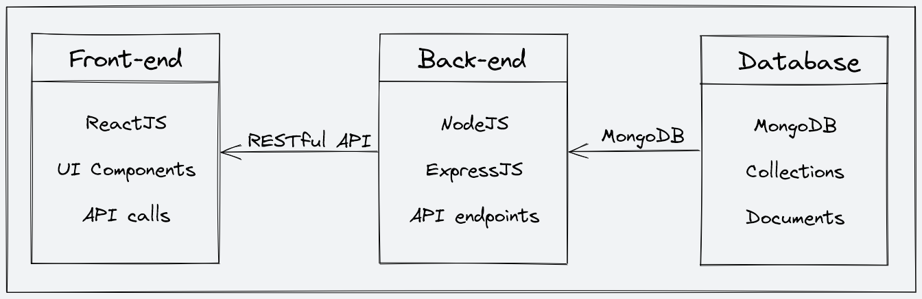
Web Application
System Architecture
Frontend:
For Students
For Employees
Backend
Authentication and Authorization
User Roles
User Authentication using OTP
Cloud Based User Management

Slide 23

Home Page

Slide 24

Signup Page

Slide 25

Login Page

Slide 26

Email Verification using OTP

Slide 27
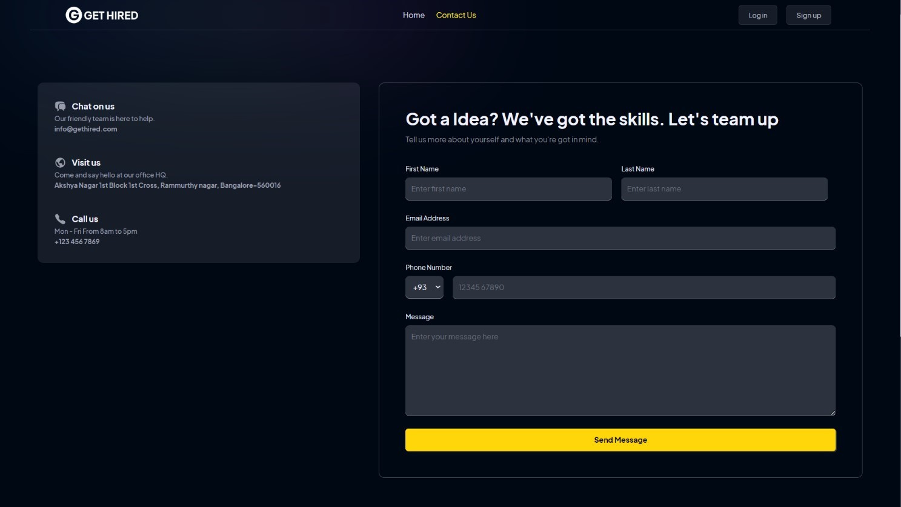
Contact Page

Slide 28
Job Search
Job scraping through Selenium is a powerful technique used to extract data from websites. It involves using Selenium's automation capabilities to navigate through web pages, interact with elements, and extract desired information.
In this project we are scraping real-time job post from indeed.com using selenium and store it in the database to show it to the user.
The user will enter its job role and according to it, he will be displayed the result of jobs post available right now in the market

Slide 29
Selenium
Selenium is predominantly renowned for its role in automating web application testing, its capabilities extend far beyond this fundamental use case.
Selenium Webdriver
The key aspect of Selenium WebDriver is its ability to handle a wide range of browser interactions. This includes clicking on elements, entering text into fields, submitting forms, navigating through pages, and handling alerts and pop-ups.
Selenium will enter the job role in indeed.com and search it, and when the result are displayed it will scrape it and provide the result.

Slide 30
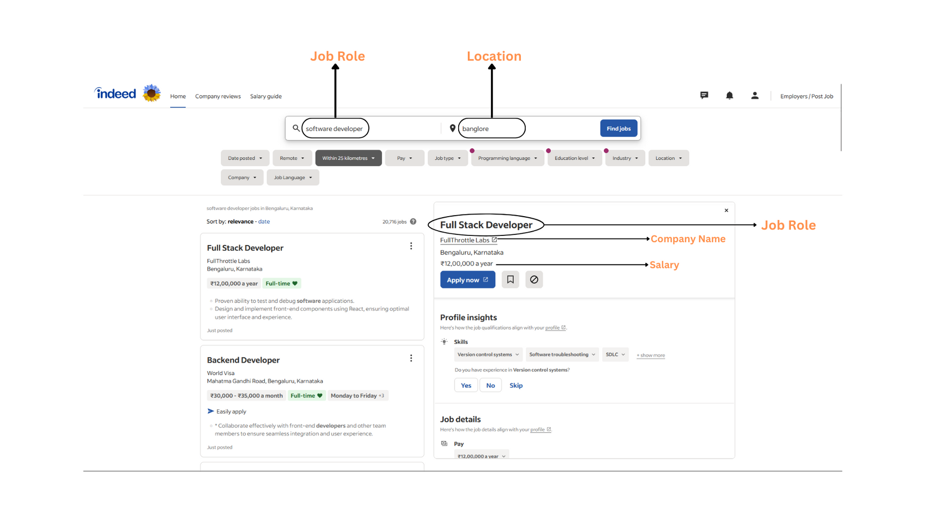
Indeed Job scraping

Slide 31
﻿THANK YOU

